Slide 1
Micro Air Vehicle Rotor Design Considerations
Principal researcher-Travis Skinner, Arizona State University
Industry advisor-Ron koontz, The Boeing Company
Notes:
I’ve been interested in drones and micro air vehicles for quite a while. In fact, I am a member of Arizona State University’s Micro Air Vehicle Club and have been involved in their work for about a year. As a member of the club and as someone with a general interest in the future of drones and micro air vehicles I am interested in optimizing the performance of these ingenious vehicles.

Slide 2
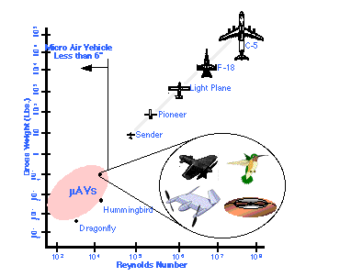
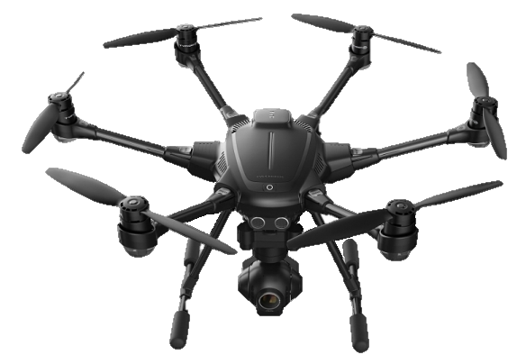
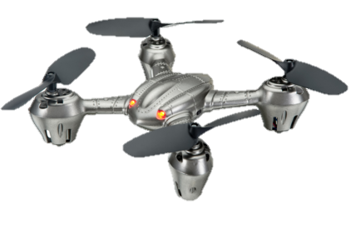
Micro air vehicle (MAV)
Technically less than 6 in³
Term used loosely to describe
“very small” air vehicles
Taken from https://www.radioshack.com/
Taken from https://3dr.com/solo-drone/
Taken from http://fas.org/irp/program/collect/docs/mav_auvsi.htm
Notes:
Before I get too far ahead of myself, I want to make sure we’re clear on the definition. Just how small does an air vehicle have to be in order to be considered “micro?”
The technical definition is no more than 6 inches in any dimension.
(figure 1) This is what the technical definition would consider “micro” air vehicles.
Generally though the term is used fairly loosely to describe air vehicles that are very small as these drones you see here.
These drones produce lift with rotary wings (propellers). If I optimize propeller, I improve performance of many different types of drones.

Slide 3
Key Propeller Parameters
Low speed MAVs can be characterized by studying hover case and the following parameters
Chord Length
Blade Twist
Number of Blades
Notes:
The project I was working on was to optimize the hover case, so I focused on chord length, blade twist, and number of blades. Most commercial propellers are designed to improve forward flight, so hover suffers. For low speed applications, the best performance is seen by optimizing blades for hover. This is done by finding the best combination of chord length, blade twist, and number of blades.

Slide 4
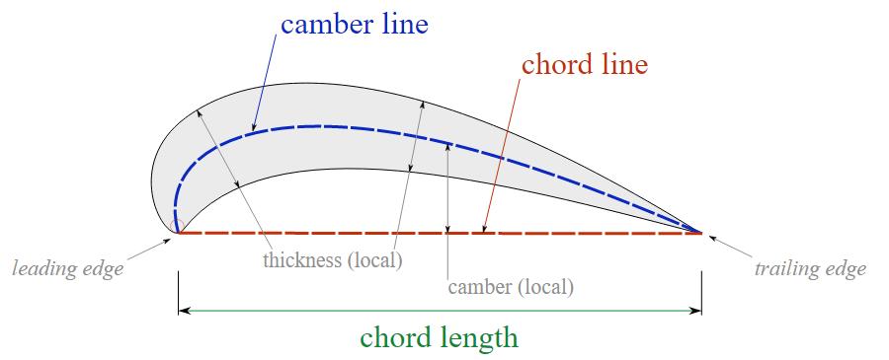
Chord length
Imaginary line from blade leading edge to trailing edge
Taken from https://commons.wikimedia.org/w/index.php?curid=17494480

Slide 5
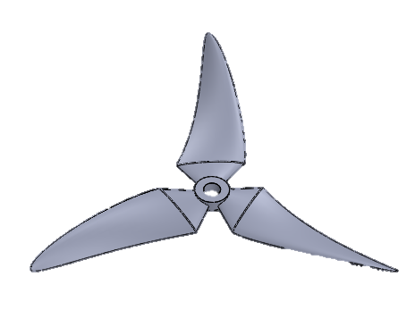
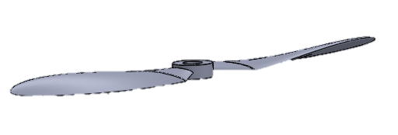
Blade twist Blade Number
Variation in airfoil pitch from blade root to tip
Varies angle of attack along blade length to maximize overall lift and equalize lift distribution along blade
Typical MAVs utilize two or three bladed propellers
Notes:
Discuss how blade twist equalizes lift distribution.

Slide 6
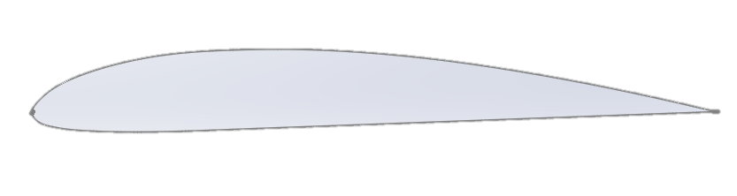
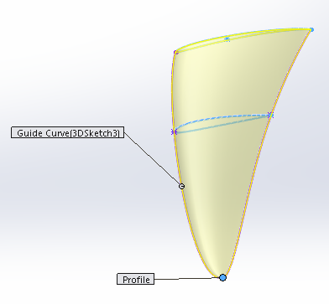
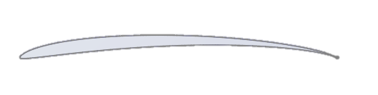
Designing
Custom combinations of airfoil profiles
Clark Y
Eppler E63
Blade design using SolidWorks 2015
Notes:
Describe process of blending rotor profiles in SolidWorks.
Eppler E63: Generates more lift—used close to root. Especially good for small, low Reynolds number applications.
Transition to ClarkY at about 1/3 the length of the blade.

Slide 7
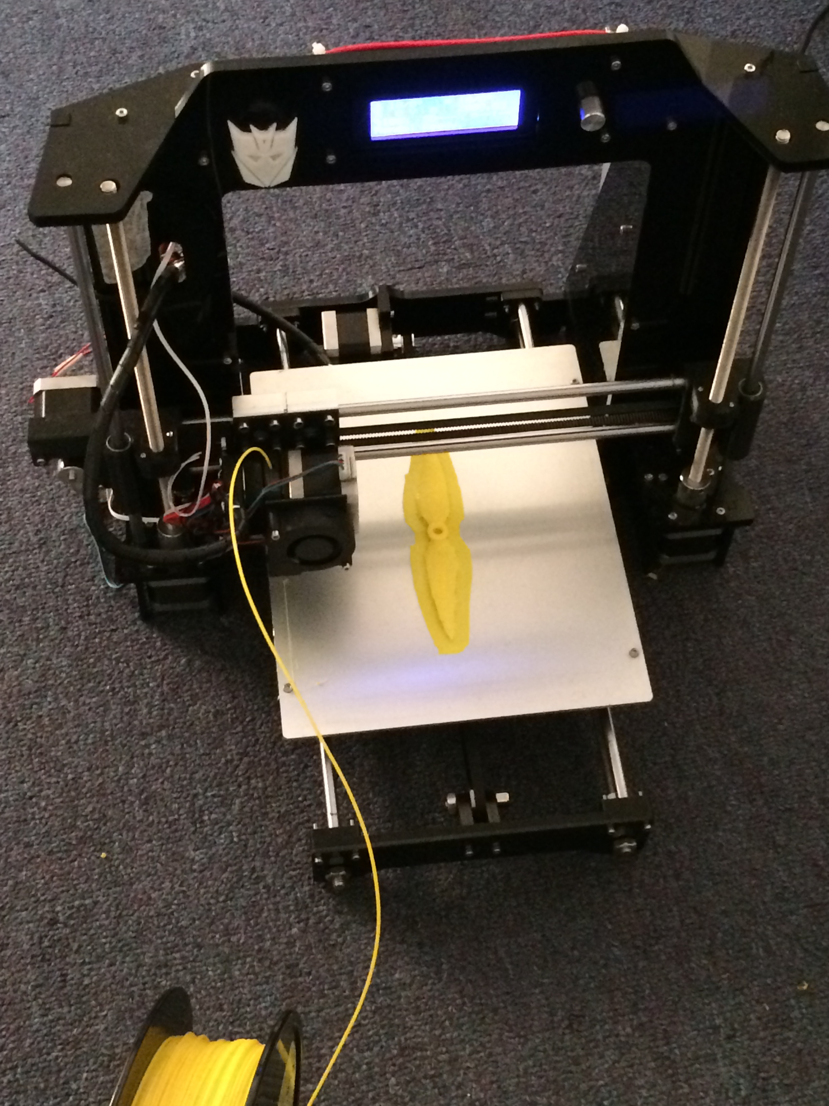
3-D Printing
3-D Printing Technology using PLA plastic
Notes:
Talk about how we built the printer and used it to print the propellers
PLA stands for polylactic acid

Slide 8
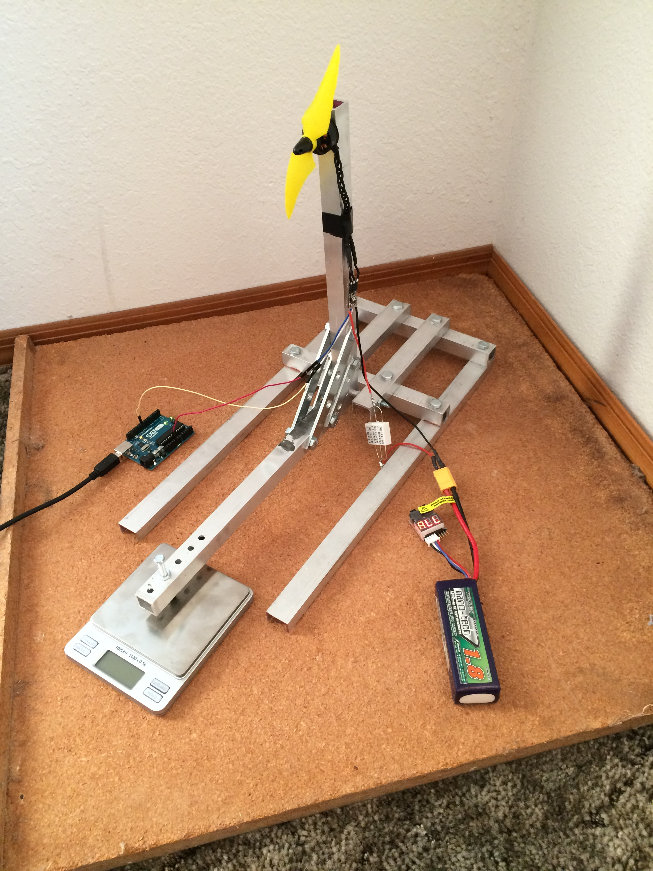
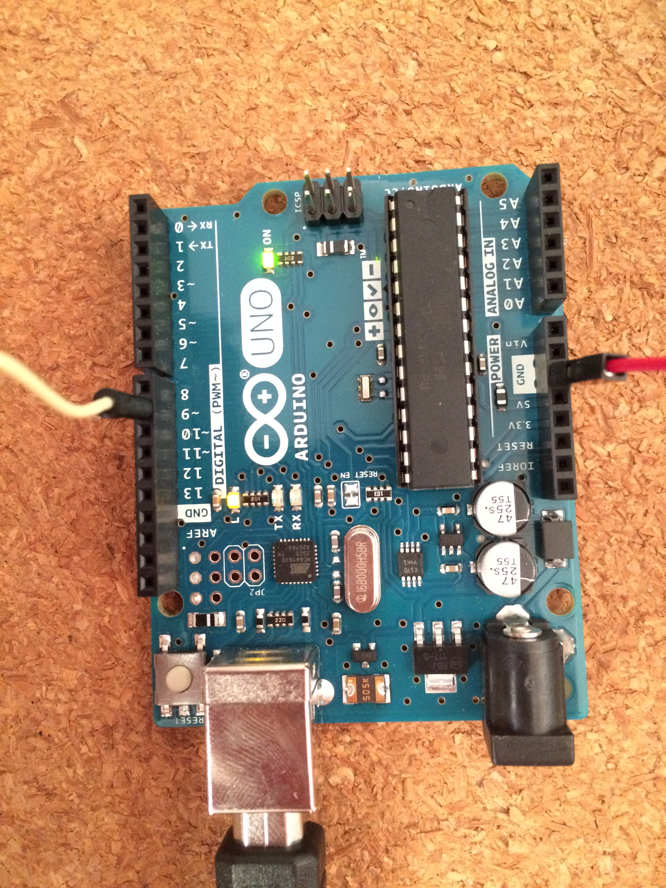
Parametric parameter Testing
Throttle control with Arduino Uno Microcontroller
Custom test apparatus for measuring propeller thrust

Slide 9
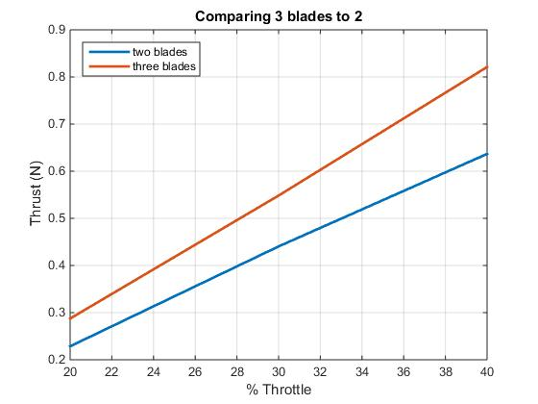
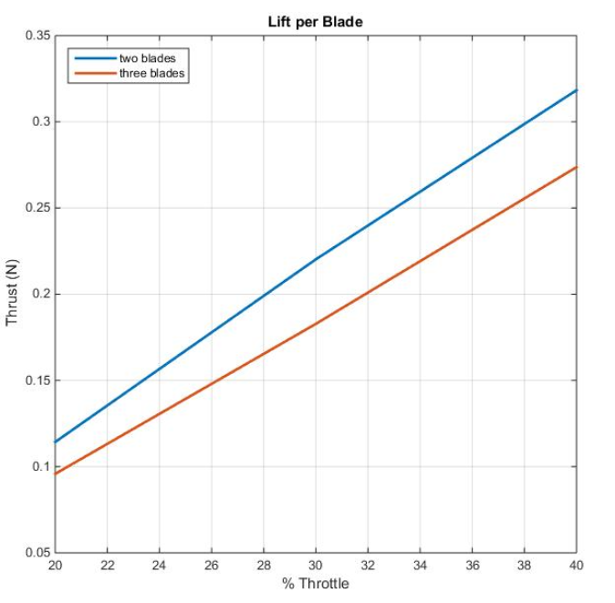
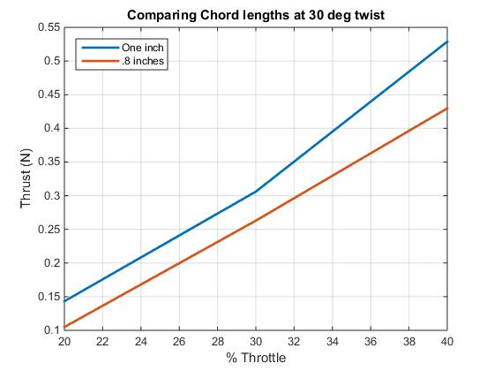
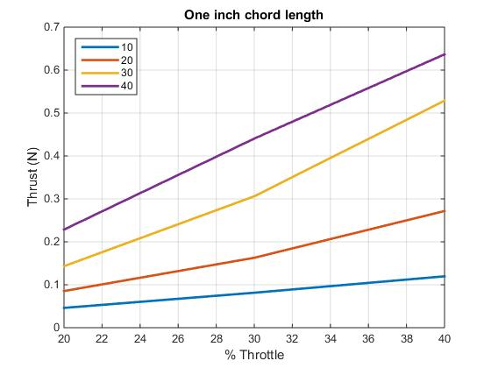
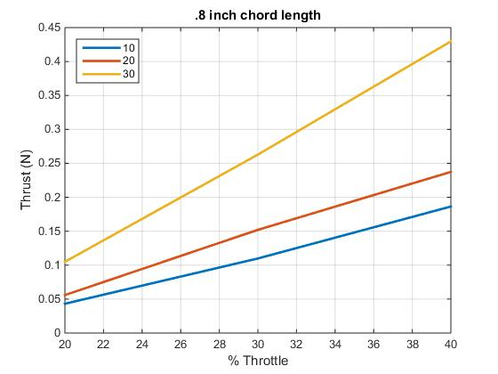
RESULTS-NUMBER OF BLADES
RESULTS-CHORD LENGTH
RESULTS-BLADE TWIST
3 blades produce more thrust than 2 blades for same throttle setting
Lift per blade significantly decreases
Thrust increases as twist angle increases
Larger chord length generates higher thrust

Slide 10
Conclusions and Future work
In general:
  Higher blade twist means better lift
  Larger chord length generates more lift
  More blades generate more lift
Each improvement comes at a cost.
Future Work
  Determine relative cost of blade improvements in terms of battery drain
  Further analysis of motor performance
Notes:
Is a marginal increase in lift worth doubling the print time?

